Slide 1
Unit 1
Object Oriented Concepts (8hrs)
Presented by
Er.Harendra Bikram Shah
Lecturer
Department of BE Computer

Slide 2
OUTLINES
  Object Oriented Programming Paradigm
  A way of viewing World Agent
  Procedure Oriented vs Object-Oriented Programming
  Features of Object-Oriented Programming: Class and Object, Data Abstraction, Encapsulation, Inheritance, Polymorphism, Message passing
  Computation as Simulation, Coping with Complexity and Abstraction Mechanisms
  Object Oriented Analysis and Design: Introduction, Responsibility Driven Design (RDD), Component Responsibility and Collaborator (CRC) Cards, Responsibility Implies Non-Interference, Programming in Small and Programming in Large

Slide 3
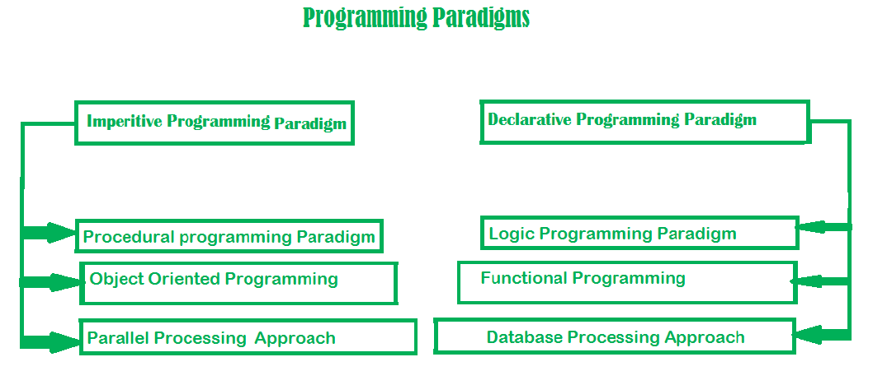
  OBJECT ORIENTED PROGRAMMING PARADIGM
Paradigm is termed as method to solve some problem or do some task.
Programming paradigm is an approach to solve problem using some programming language

Slide 4
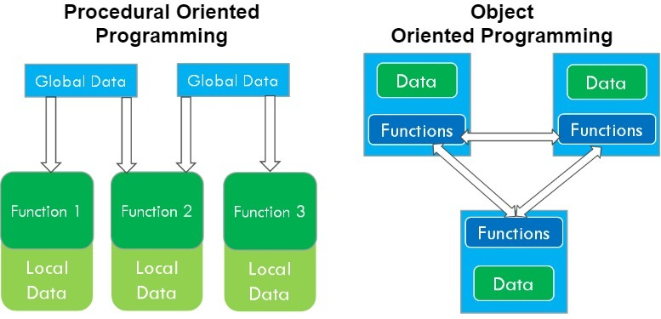
  OBJECT ORIENTED PROGRAMMING PARADIGM
It is a programming paradigm based on the concept of objects which can contain data and code data in the form of fields (often known as attributes or properties),
code in the form of procedures (often known as methods).

Slide 5
  HISTORY OF OBJECT ORIENTED PROGRAMMING PARADIGM
Year | Milestone
1960s | - Simula: Developed by Ole-Johan Dahl and Kristen Nygaard, Simula is considered the first object-oriented programming language. It introduced concepts like classes, objects, and inheritance.
1970s | - Smalltalk: Developed by Alan Kay, Smalltalk was a pure and highly influential OOP language that popularized key OOP concepts such as message passing, encapsulation, and polymorphism.
1980s | - C++: Developed by Bjarne Stroustrup, C++ extended the C programming language with OOP features, including classes, inheritance, and polymorphism. It became widely used for systems programming and application development.
1990s | - Java: Developed by James Gosling at Sun Microsystems, Java combined OOP concepts with platform independence (via the JVM), making it a versatile and widely adopted language for enterprise and web applications.
 | - Python: While not strictly OOP from the start, Python evolved to support OOP principles with classes, objects, and inheritance, becoming a popular language for both OOP and procedural programming.
2000s | - C#: Developed by Microsoft, C# was designed as a modern, object-oriented language for the .NET framework, incorporating features from C++, Java, and Visual Basic.
Present | - JavaScript: Originally a scripting language, JavaScript has evolved to support OOP concepts with prototypes and classes, becoming essential for web development and front-end technologies.
 | - Swift: Developed by Apple, Swift is designed to be a modern, safe, and expressive language for iOS, macOS, watchOS, and tvOS development, embracing OOP principles.

Slide 6
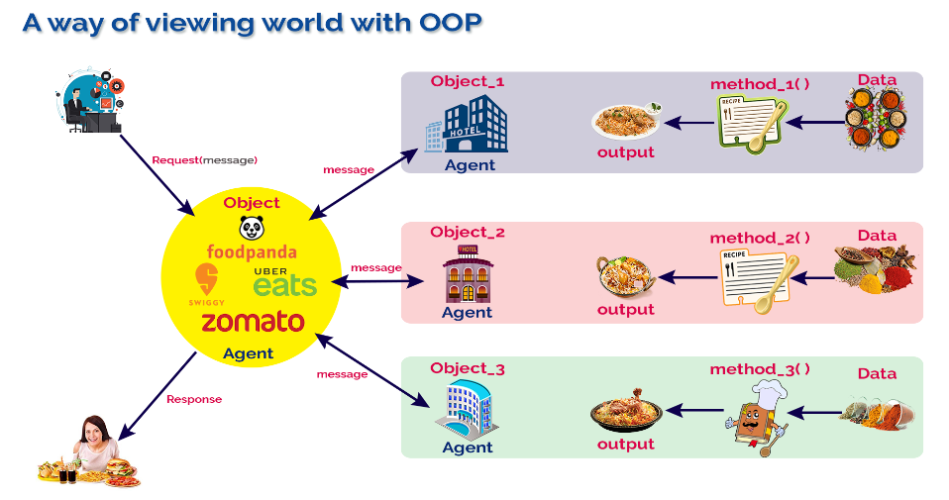
  A way of viewing World Agent

Slide 7
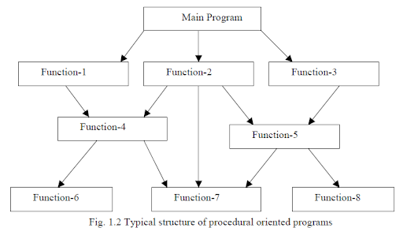
  Procedural Oriented Programming Language

Slide 8
  Procedural Oriented Programming Language
Pros | Cons
- Easy to understand and learn for beginners. | - Limited scalability for large projects.
- Straightforward flow of control with step-by-step execution. | - Code can become lengthy and repetitive.
- Encourages breaking down tasks into procedures or functions. | - Limited support for data encapsulation and abstraction.
- Facilitates code reusability through modular design. | - Global variables can lead to maintenance issues.
- Generally efficient in terms of execution speed and memory usage. | - Lack of support for parallel processing.
- Easier to debug due to sequential execution of statements. | - Harder to trace errors in large, interconnected codebases.
- Provides direct access to memory locations (pointers in some languages). | - Increases the risk of memory leaks and pointer errors.
- Promotes structured programming with clear procedure definitions. | - Limited support for higher-level abstractions and concepts.
- Code is generally more portable across different platforms. | - May lack built-in support for object-oriented or event-driven paradigms.
- Can offer better performance optimization opportunities. | - May not be as optimized for specific problem domains as other paradigms.

Slide 9
  Features of OBJECT ORIENTED PROGRAMMING
Dynamic Binding
Class
Object
Message Passing
OOP Features
Inheritance
Abstraction
Encapsulation
Polymorphism

Slide 10
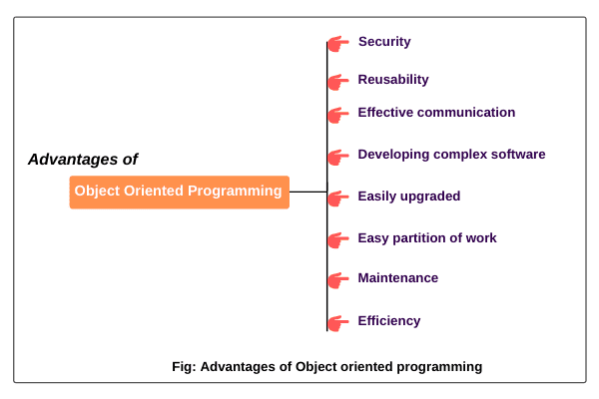
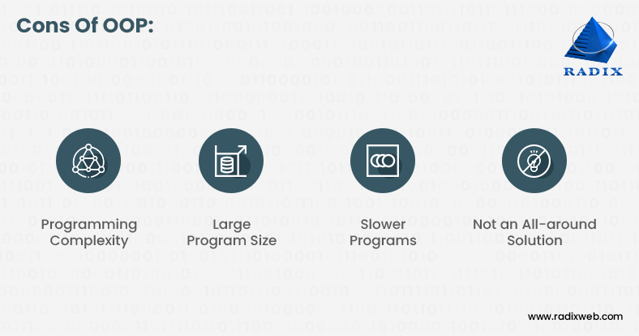
  Pros and Cons of OBJECT ORIENTED PROGRAMMING
Cons of OOPL

Slide 11
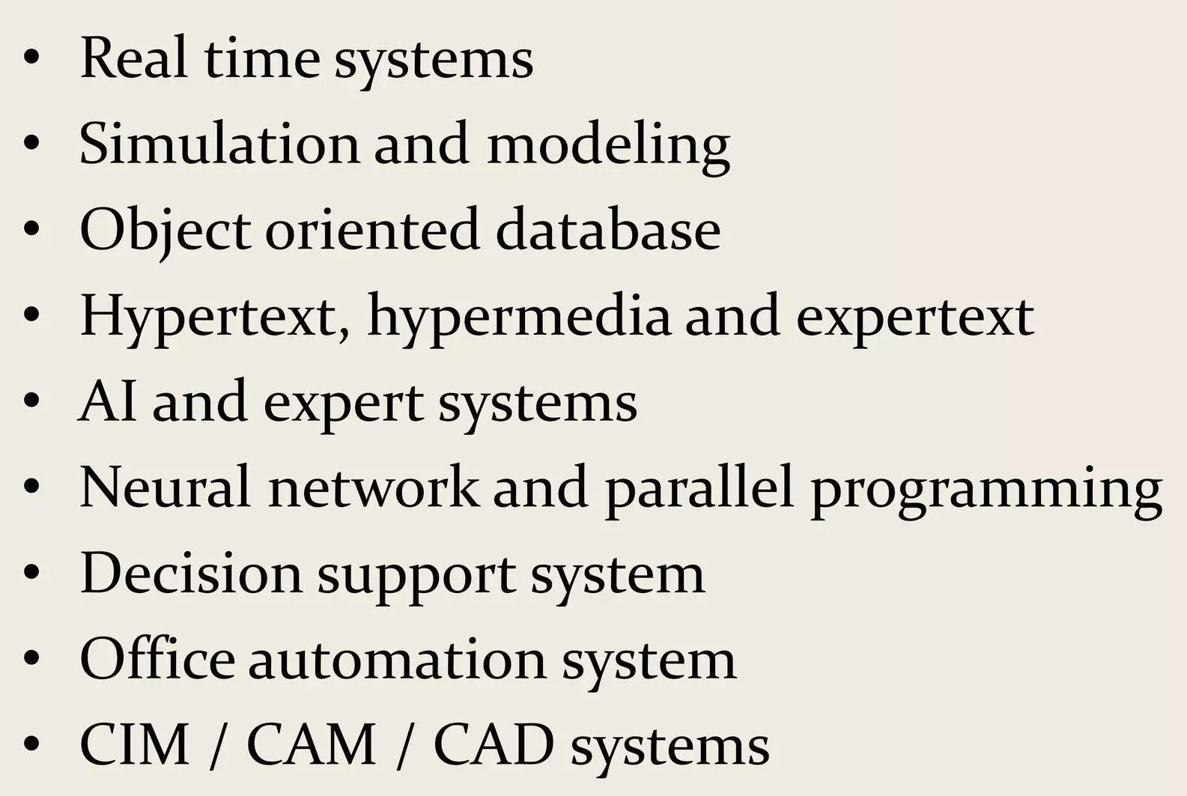
  Application Areas of OBJECT ORIENTED PROGRAMMING

Slide 12
  OOP vs POP
Parameter | Object Oriented Programming | Procedural Programming
Definition | programming language that uses classes and objects | Programming language that follows a step-by-step approach
Approach | Bottom Up | Top to Bottom.
Security | more secure than POP. | less secure as compare to OOPs.
Complexity | less complex and new data objects can be created easily from existing objects. | There is no simple process to add data in procedural programming
Program division | OOP divides a program into small parts and these parts are referred to as objects. | Procedural programming divides a program into small programs and each small program is referred to as a function.
Importance | OOP gives importance to data rather than functions or procedures. | In POP, functions along with sequence of actions are followed.
Examples | C++, C#, Java, Python, etc. are the examples of OOP languages. | C, BASIC, COBOL, Pascal, etc. are the examples POP languages.

Slide 13
  Computation as Simulation
Powerful way to model real-world systems.
Involves modelling real-world process using objects and interactions between them
working:
The Simulation Mindset:
We view the program as a simulated world where objects represent entities and their interactions mimic real-world behaviors.
computation as simulation can be approached within OOP:
Identify Entities and Interactions
Define Classes for Entities
Simulate Interactions
Execute Simulation
Example: Traffic Simulation, military Simulation

Slide 14
  Coping with Complexity and Abstraction Mechanisms
Essential Aspect of Software Development
Two challenges are Complexity and Abstraction
  Techniques to Cope with Complexity and Abstraction
Using Metaphors and Analogies
Using Visual Representation
Using Natural Language

Slide 15
OBJECT ORIENTED ANALYSIS AND DESIGN
Object Oriented Analysis
Process of Finding and describing objects or concepts in Problem Domain
Requirement Analysis
Object Based Analysis
Object Oriented Design
Define objects and Their Collaboration to fulfill Requirements
Conceptual Solution of real Problem Domain
System Modeling [like map]
(OOAD) is a software engineering methodology that employs object-oriented principles to model and design complex systems.
BASIC PRINCIPLES OF OOA
The information domain is modelled
Behaviour is represented
The function is described
Data, functional, and behavioural models are divided to uncover greater detail
Starting Simple, Getting Detailed:

Slide 16
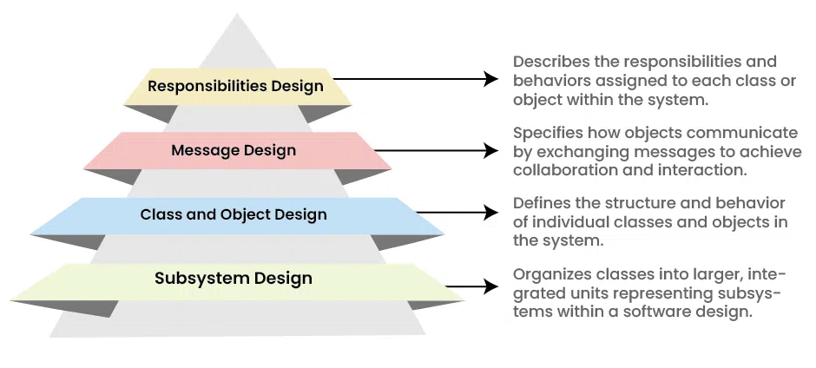
OBJECT ORIENTED ANALYSIS AND DESIGN
Object Oriented Design Pyramid

Slide 17
Benefits of Object-Oriented Analysis and Design(OOAD)
Improved modularity:
Better abstraction:
Improved reuse:
Improved communication:
Reusability:
Scalability:
Maintainability:
Flexibility:
Improved software quality:
Challenges of (OOAD)
Applications of (OOAD)
Complexity:
Overhead:
Steep learning curve:
Time-consuming:
Rigidity:
Cost:
Financial Systems:
Healthcare Systems:
Aerospace and Defense:
Telecommunications:
E-commerce:

Slide 18
RESPONSIBILITY DRIVEN DESIGN (RDD)
focuses on identifying the responsibilities of objects in a system.
objects should be responsible for a single, well-defined task.
improve the clarity and maintainability of the code.
The basic steps of RDD are as follows:
Identify the system's requirements.
Identify the objects in the system.
Assign responsibilities to the objects.
Define the interactions between the objects.
Implement the design

Slide 19
RESPONSIBILITY DRIVEN DESIGN (RDD)
Benefits of using RDD:
Improved clarity
Improved maintainability
Improved flexibility
Challenges of using RDD:
time-consuming to use.
requires a good understanding of object-oriented design principles.
difficult to use for complex systems.

Slide 20
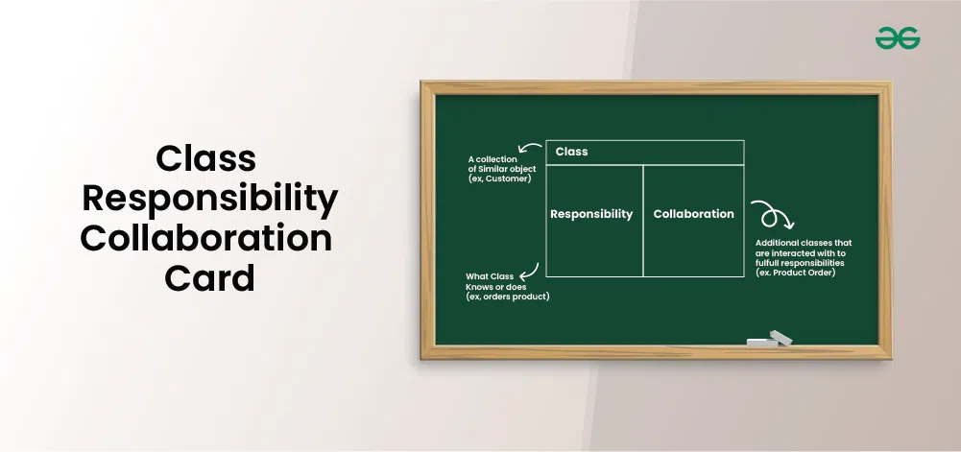
Component Responsibility and Collaborator (CRC) Cards
structured tool used in object-oriented software design.
design tool used in software development and object-oriented programming
Takes essential information about a class, including its name, responsibilities, and collaborations with other classes.
Introduced by Ward Cunningham in 1989

Slide 21
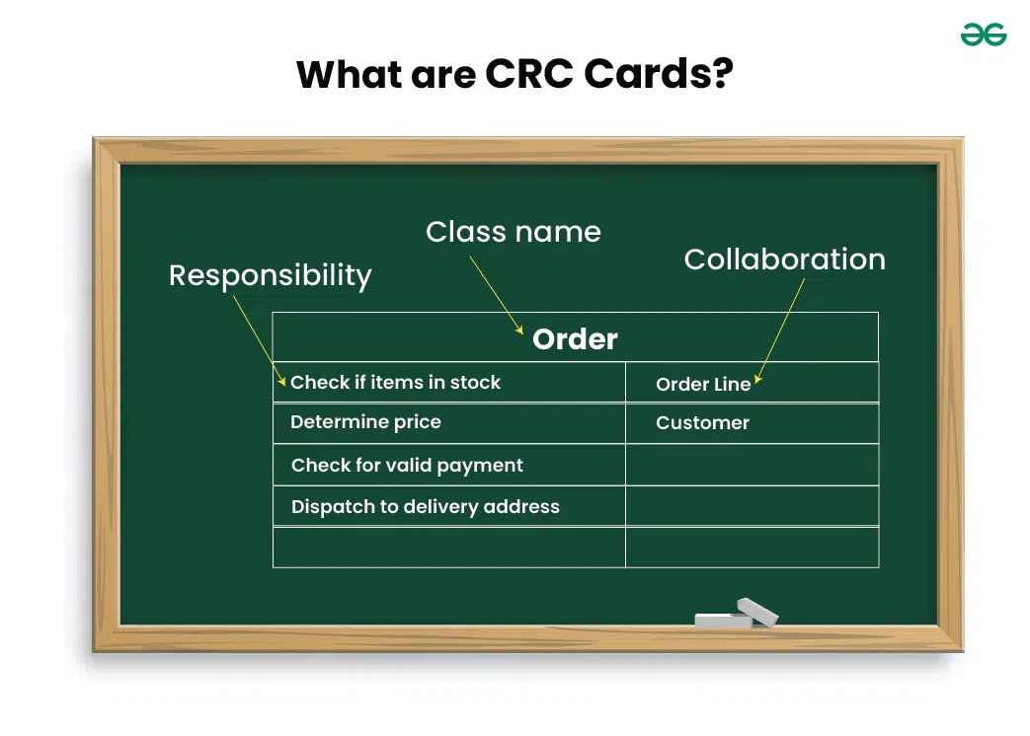

Slide 22
PURPOSE OF CRC CARDS IN SOFTWARE DESIGN
Clarify Class Responsibilities:
Identify Collaborations:
Encourage Communication and Collaboration
Iterative Design and Refinement:
Benefits of Using CRC Cards
Visualization:
Collaboration:
Clarity and Understanding
Iterative Design:
Rapid Prototyping:

Slide 23
How to Create CRC Cards?
Step 1: Identify Classes:
Step 2: List Responsibilities:
Step 3: Define Collaborations:
Step 4: Create Cards:
Step 5: Organize Cards
Some guidelines and best practices for using CRC cards:
Keep it Simple and Concise:
Focus on Responsibilities:
Use Active Collaboration:
Iterate and Refine:
Validate Requirements:
Keep Cards Organized:

Slide 24
Applications and Use Cases of CRC Cards
Requirement Analysis:
System Design:
Object-Oriented Design:
Domain Modelling:
Refactoring:
EXAMPLES OF CRC CARDS:
Bank CRC cards:
  Card for a BankAccount class:
    Class name: BankAccount
  2. Card for a Customer class:
    Class name: Customer
    Responsibilities:
      Open a bank account
      Close a bank account
      Deposit money
      Withdraw money
      Check balance
    Collaborators:
      BankAccount
      Bank
Responsibilities:
      Deposit money
      Withdraw money
      Check balance
      Collaborators:
      Bank
      Customer

Slide 25
  RESPONSIBILITY IMPLIES NON-INTERFERENCE
Design principle in OOP that states that objects should be designed to be independent of each other.
objects should not interfere with the internal workings of other objects.
RIN is based on the idea that objects should be designed to be loosely coupled.
Benefits of RIN:
Increased flexibility:
Improved performance:
Reduced complexity:

Slide 26
Concept | Computation as Simulation | Responsibility implies Noninterface
Definition | Computation viewed as simulating or emulating processes or phenomena | Implication that responsibility excludes direct interaction
Focus | Modeling and simulating behavior of systems or phenomena | Assigning accountability without direct interaction
Purpose | Understanding and studying complex systems | Determining obligations or duties without direct engagement
Application Areas | Physics, biology, economics, computer science | Ethics, organizational management, decision-making
Nature of Interaction | Indirect and simulated interaction with modeled systems | No direct interaction or interface required for accountability
Examples | Simulating weather patterns, modeling molecular interactions | Holding a CEO responsible for company performance
Key Characteristics | Reproduces behavior, predicts outcomes | Accountability without direct control or influence
Key Considerations | Accuracy of simulation, fidelity to the real system | Clarity of responsibilities, alignment with organizational goals

Slide 27
END of UNIT 1

